Slide 1
USchedule Resolving Scheduling Woes
402 Senior Project
Annie Flora, Amelia Jay, Liam Namba, Cristalina Nguyen, Sophia Prochnow, Christian Santander

Slide 2
The Problem
LAC+USC psychiatry residency program has 24 residents who rotate through the facility under Chief Resident Dr. Kelly Jones.
Dr. Jones is responsible for the creation of a call schedule over multiple wards, patient time-off requests, and scheduling constraints for the hospital.
We want to continue to work on USchedule, adding more constraints and optimizing our algorithm.
Notes:
ANNIE
Same problem and reiterate - state that we are continuing to work to add more constraints and optimize alg
LAC (Los Angeles County)+USC psychiatry residency program has an inpatient locked facility at Augustus Hawkins Hospital. During the course of the year, 24 residents rotate through the facility (interns and second-year residents). Chief resident of this site is responsible for the creation of a call schedule for the year which takes into account different responsibilities

Slide 3
“We want to create a webapp that can take the residents’ preferences and generate a call schedule using constraints given, to both accelerate and automate the process”
Notes:
LIAM
Talk about how far along we are with this and what more needs to be done

Slide 4
Hopes and Requirements
MVP (Minimum Viable Product)
Minimum # of different shifts
2 month rotation block
Balancing resident experience per ward
Vacation requests
Future Phases
Ensure every constraint requested by Dr. Jones is satisfied
Allow residents to swap shifts without going through the admin
Ability to set constraints on groups instead of individuals
Notes:
LINA
Talk about what mvps we have completed and what we still need to accomplish … stars are complete
State that future phases is what we will be tackling this semester
For MVP (or minimum viable product which is basically the first iteration or launch of the product), we will fulfill the baseline requirements that Dr. Jones asked for. These include
Having a minimum number of people on the 4 different shift types:
Day float (person on call during the day when the rest of the team members leave)
Night float (person on call who covers the entire hospital overnight)
Long call and short call (people who cover the hospital over the weekend)
Each resident will rotate over the course of a two month block
Be able to take vacation block requests into account if possible
Balance each ward with second and first year residents so that each ward is equivalent in terms of resident knowledge/experience
In future phases a couple things that we would like to accomplish will be to:
Allow residents to autonomously swap shifts without needing approval from Dr. Jones
Setting constraints on groups of people rather than each person individually
Scaling to broader use cases - this includes expanding to other areas of the hospital/other hospitals as well as other types of businesses that need to schedule groups (like a retail business with Sales Associates, Managers, etc.)

Slide 5
Impact
Saving TIME and MONEY
Reduces time spent by Dr. Kelly on scheduling
Reduces errors in schedule by making sure ALL constraints are satisfied without brute force/trial and error methods
Notes:
SOPHIA
State that so far we have definitely checked off helping her save, but this semester will be focused on helping her save more time by finishing satisfying all of her constraints. Since we still have some missing she would have to do these by hand and our goal is for her to not have to do any constraints herself
Her time can be spent on other things
Increases revenue for the hospital by decreasing time spent by Dr. Kelly Jones on scheduling brute force
Can save time and $ for LOTs of businesses in the future once scales out (esp if schedulers are being paid by the hour b/c that will have a direct visible impact)

Slide 6
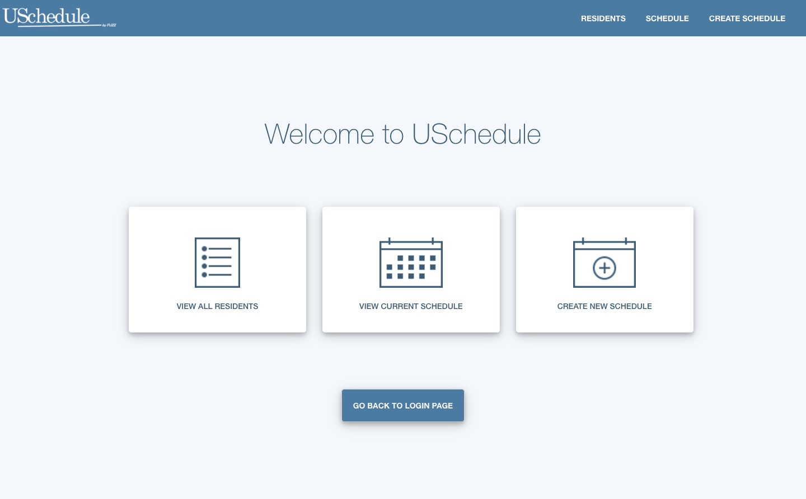
Current Status
Notes:
CHRIS
Talk about UI

Slide 7
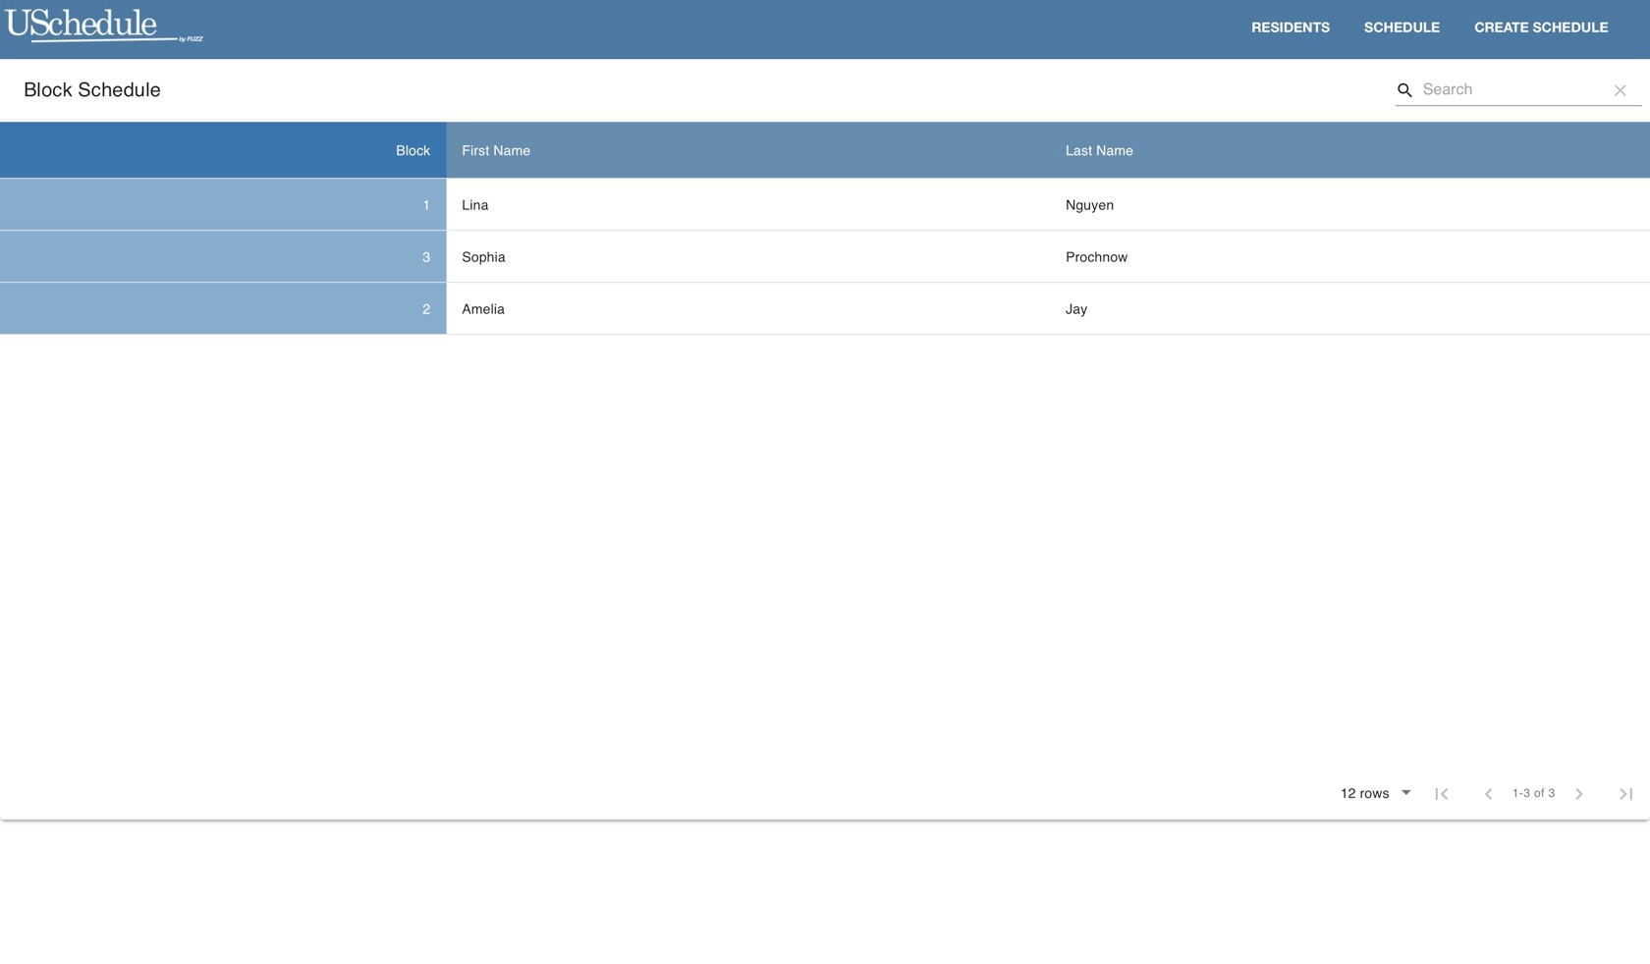
Current Status
Notes:
CHRIS
Talk about UI

Slide 8
Relevant Coursework for the project
Databases
Storing and using resident and scheduling data
Interaction Design
Web development skills
UX Design
Algorithms
Constraint Propagation
Artificial Intelligence
Forney
Maximizing expected utility
Notes:
LINA
And also 401 lol since we are continuing on from there

Slide 9
Product Development Plan
Biweekly Sprints:
Planning
Development
Iteration
Notes:
AMELIA
We have done a good job of having daily standups to stay on the same page as well as weekly meetings with our advisor forney which we will continue to do this semester. We finished an iteration and are now on a second phase of this project
We will have a daily standup to discuss our progress and bring up any challenges we’re facing. We will be meeting weekly with Forney and we are on a biweekly sprint schedule. We will also be meeting with Dr. Jones regularly throughout this process to better understand her needs and to make sure that the product we create aligns with her vision.

Slide 10
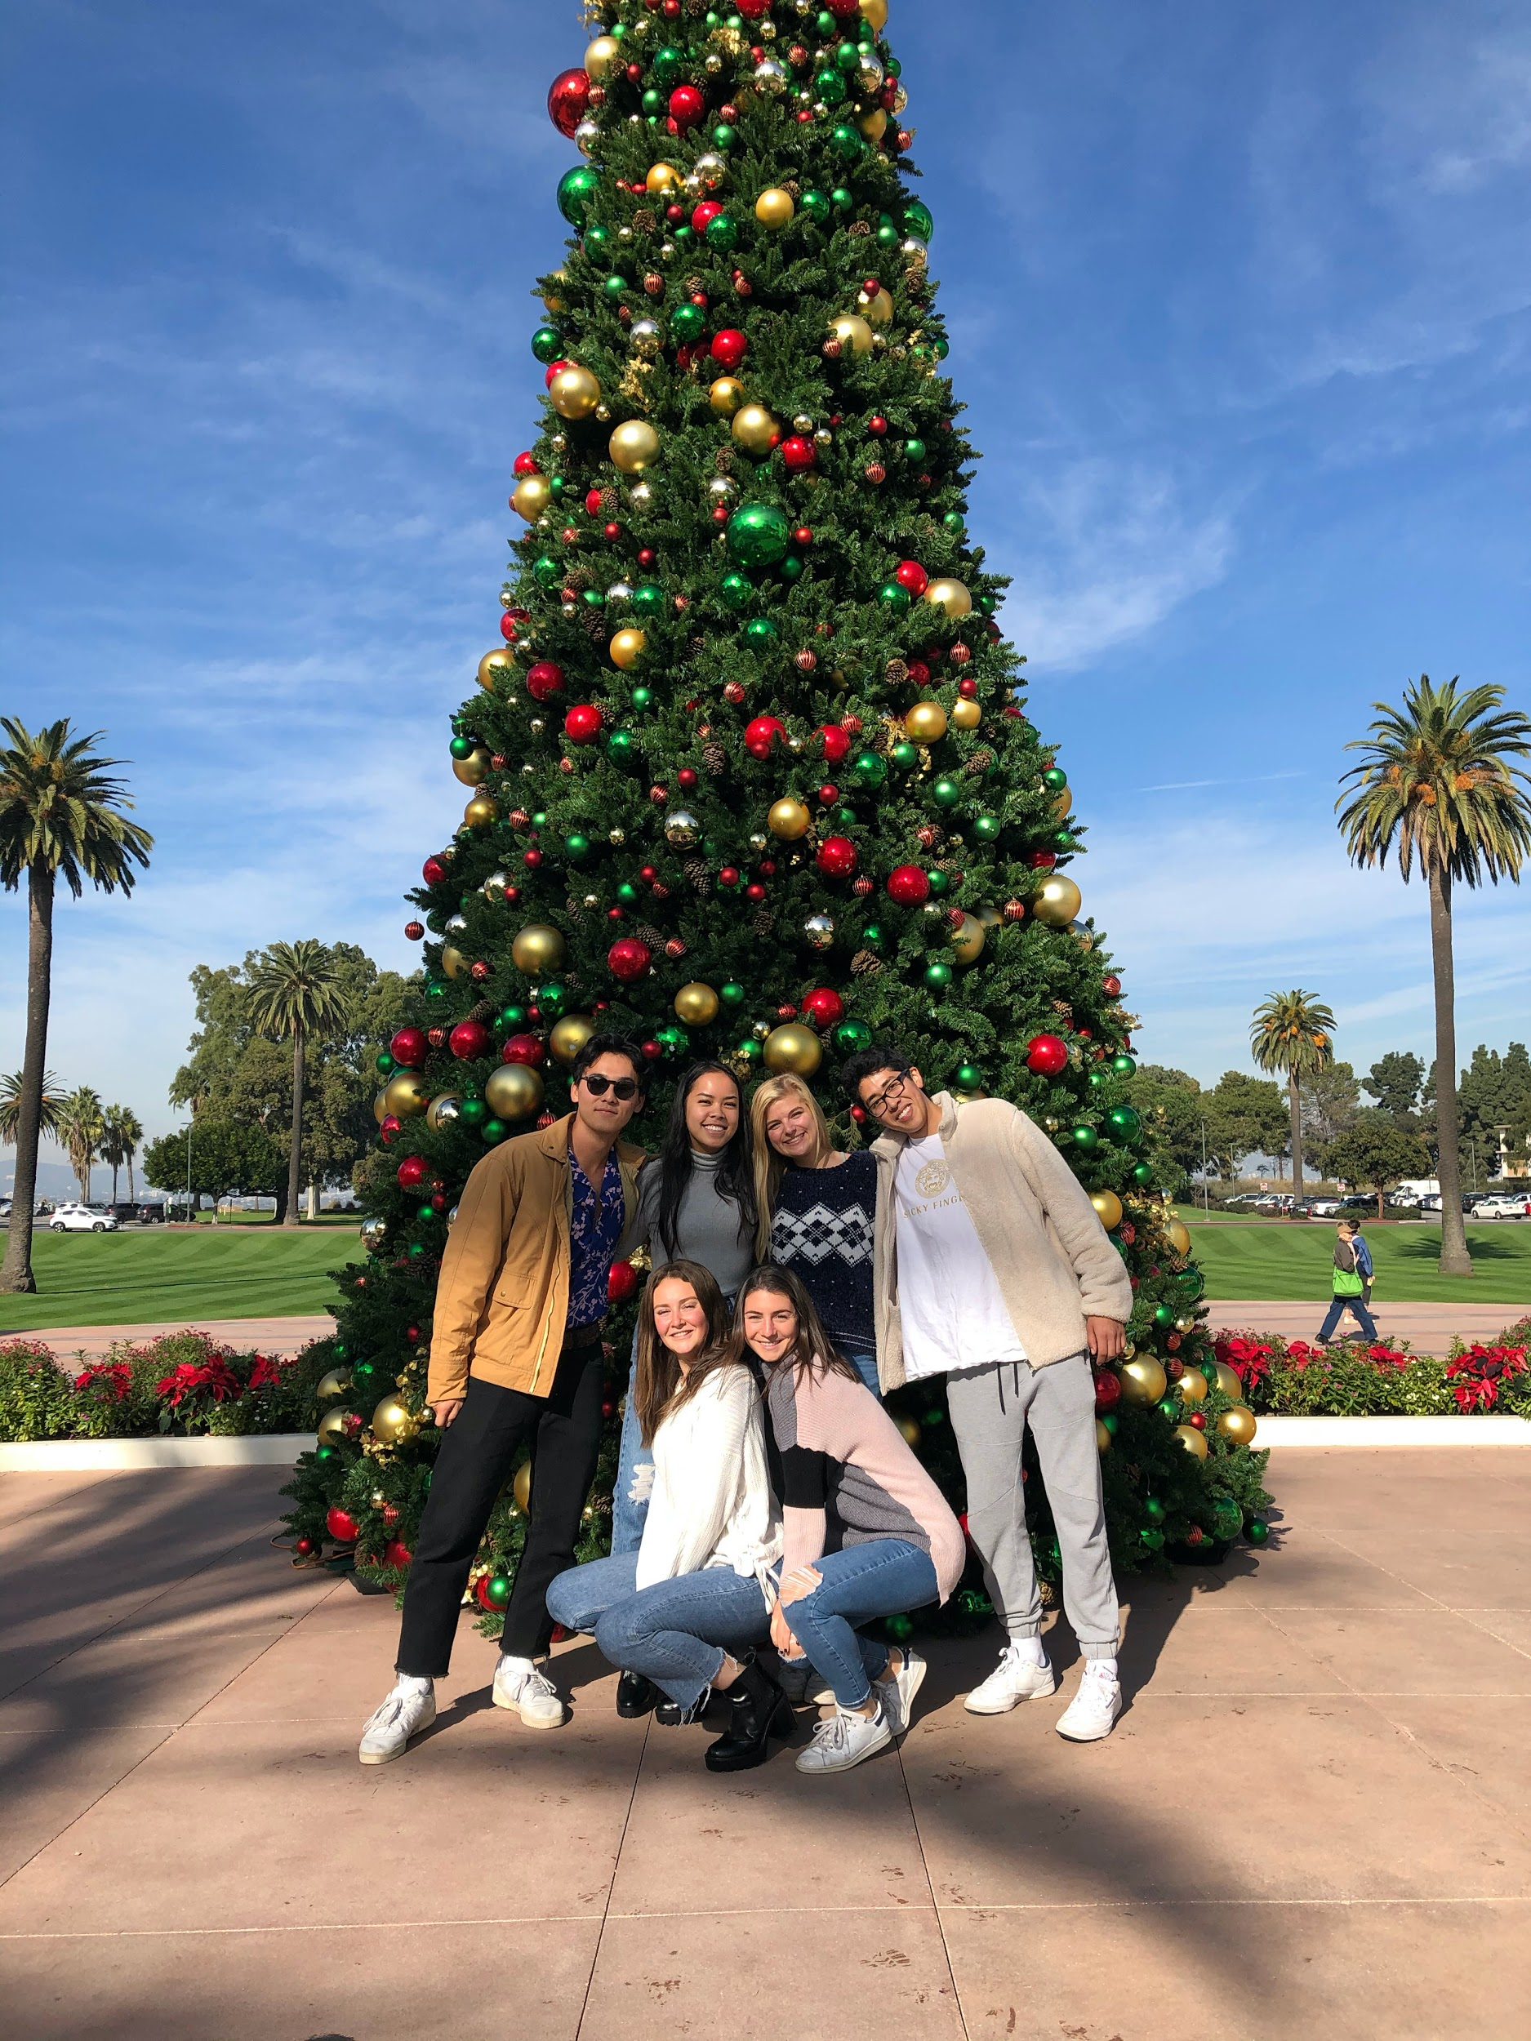
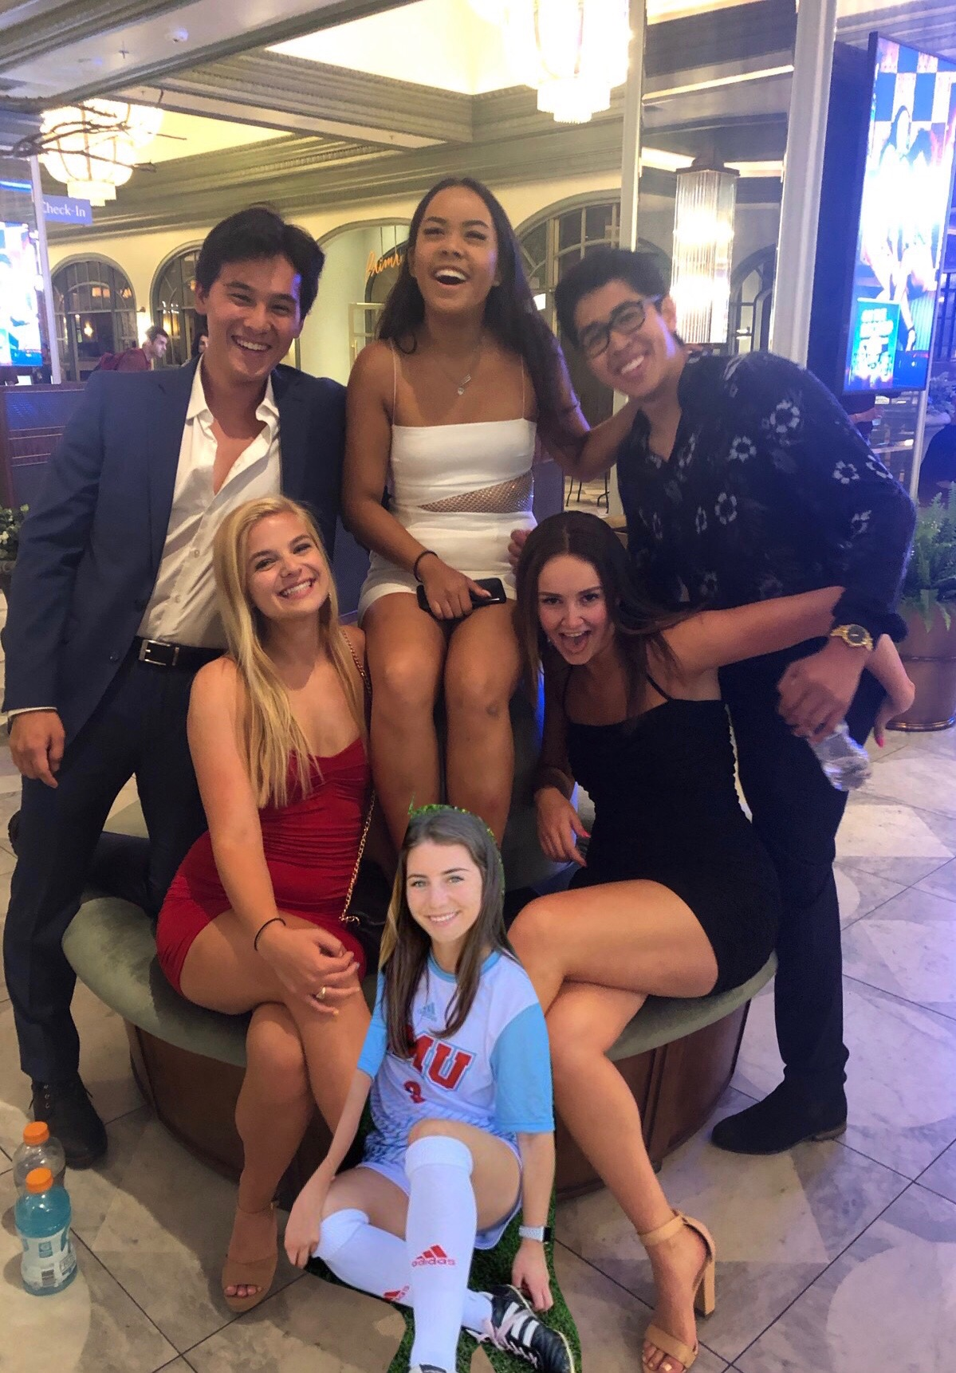
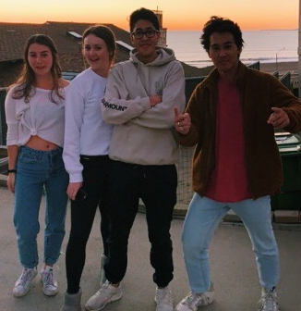
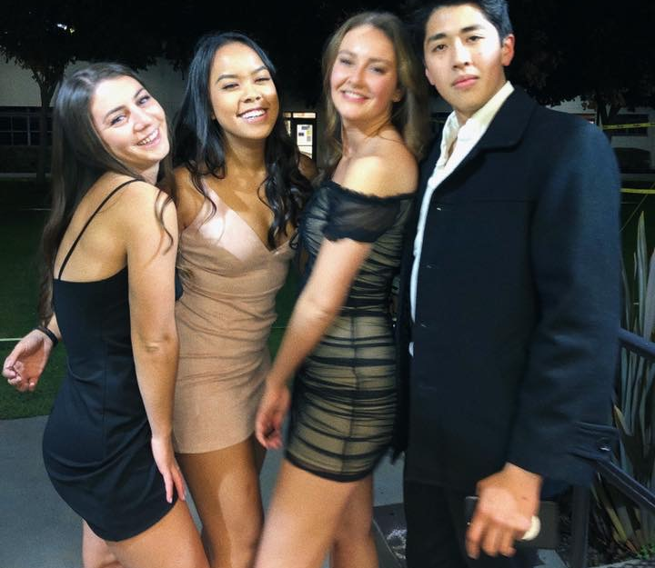
thanks!
Love, Fuzz

Slide 12
Extra graphics

